Slide 1
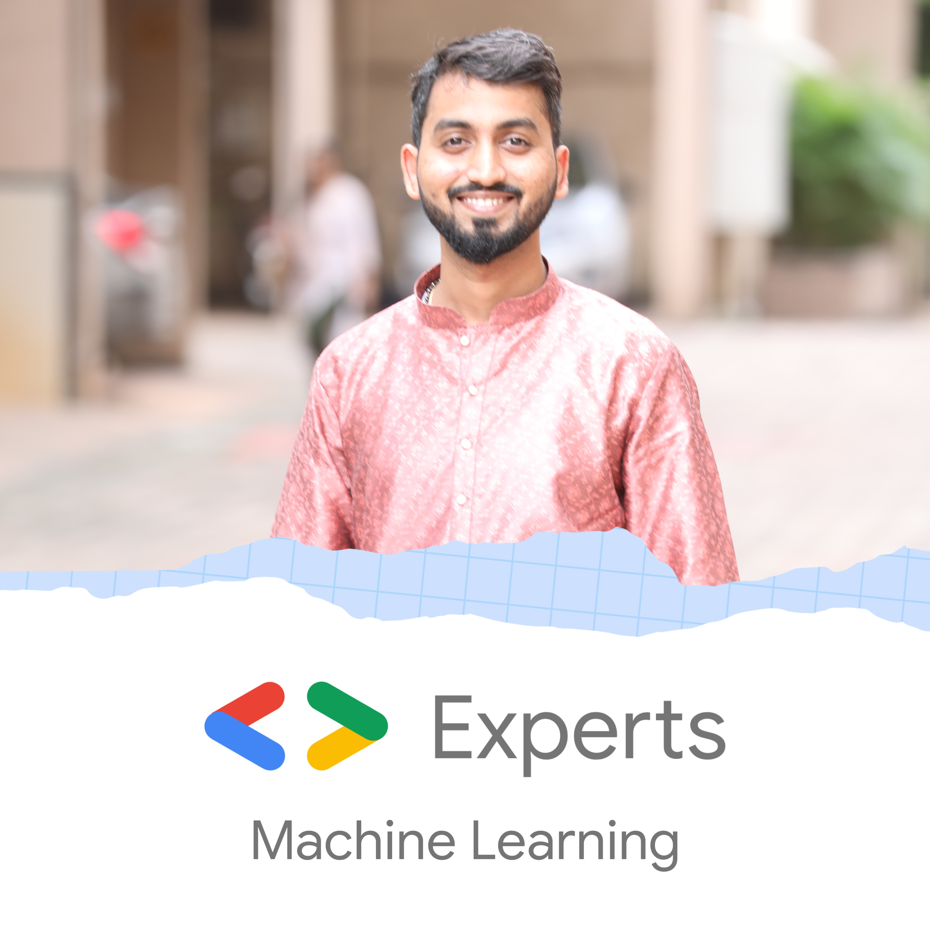

Discover ML
Nitin Tiwari
Google Developer Expert – Machine Learning Software Engineer @ LTIMindtree

Slide 2
$whoami
Software Engineer at LTIMindtree
Google Developer Expert in Machine Learning
Technical speaker; 30+ talks across India and South East Asia
Contributor to Google Dev Library
Love writing blogs on AI/ML

Slide 3
Content
What is Machine Learning?
Supervised Learning
Unsupervised Learning
Neural Networks and Hyperparameters
Some interesting examples
Resources for you to get started

Slide 4

What is Machine Learning?
The ability of computers to learn without being explicitly programmed.
Explicitly programmed? What does that mean?
So, what happens in ML?
Data
Example:
Data = 2, 3
Rule = Addition
Answer = 5
Answers
Rules
Data
Example:
Data = 2, 3
Answer = 5
Rule = Addition
Rules
Answers

Slide 5
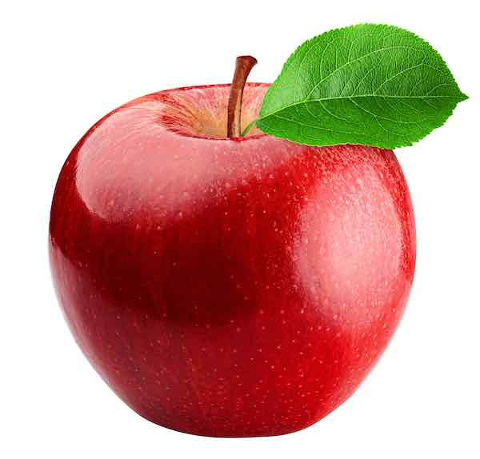

Supervised Learning
We ‘supervise’ the machine to learn by feeding it with both, the input data as well as label.
Once the machine has learned, we then feed it the data it hasn’t previously seen and expect it to predict/infer the correct label.
Example:
Apple 70%
Data
“Apple”
Unseen Data
Pears 30%
Label
Training a model
Evaluating a model

Slide 6
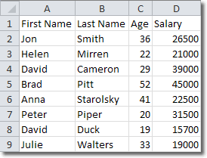

Types of Data
Data can mainly be classified into:
Structured Data
Unstructured Data
Structured Data – Data in the form of CSVs, JSON, Excel Sheets, databases, etc.
Unstructured Data – Data in the form of images, videos, emails, audio, social media posts, etc.

Slide 7
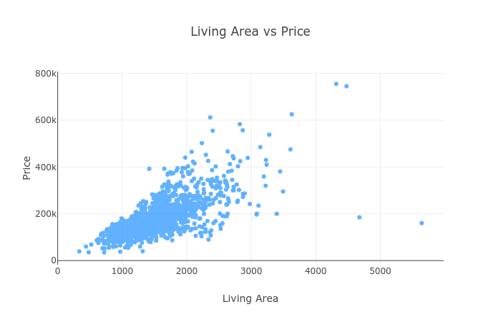
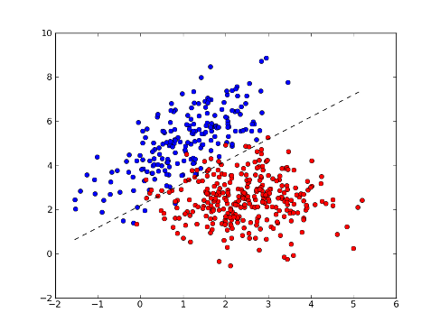
Supervised Learning on Structured Data
Supervised Learning on structured data mainly deals with –
Regression
Classification
Regression – Predict a value
Classification – Categorize into two or more classes

Slide 8

Supervised Learning on Unstructured Data
Computer Vision is a technique to solve ML problems when the data is in the form of images and videos.
Image Classification
Identify the content in the image
Output the most relevant class

Slide 9

Supervised Learning on Unstructured Data
Natural Language Processing is a technique to solve ML problems when the data format is textual or audio.
Examples:
Text-to-speech recognition (Google Search)
Speech-to-text (Digital voice assistants like Google Home, Alexa, Siri)
Email spam classifier (Gmail automatically classifies spam emails)
Hate speech recognition (YouTube comments, tweets on X, etc.)
Hello, please find the document.
You have w0n a l0tt€ry

Slide 10
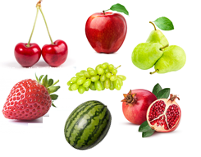


Unsupervised Learning
In unsupervised learning, as the name suggests, we let the machine train the model by learning on its own.
The machine identifies patterns from the input data.
Example:
Cluster 1
Data
Cluster 2

Slide 11
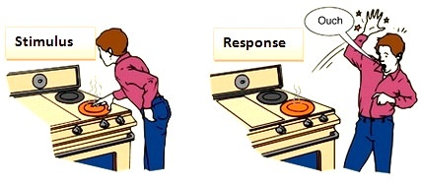
Neural Networks
What happens when you touch a hot object?
The brain sends a signal through the neurons and activates the tissue cells of your hand so that you take your hand off the hot object immediately.
Input: Signal from the brain carried by neurons.
Activation function: Tell the tissue that the object is hot.
Output: You take your hand off the hot object.

Slide 12
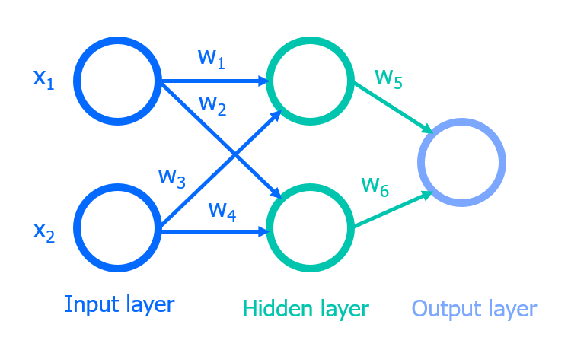
Neural Networks
In AI, we have a similar network of neurons that carry the data from one neuron to another. This network is called Artificial Neural Network or simply, Neural Network.

Slide 13
import tensorflow as tf
# Load a dataset
mnist = tf.keras.datasets.mnist
(x_train, y_train), (x_test, y_test) = mnist.load_data()
x_train, x_test = x_train/255.0, x_test/255.0
# Building a Keras sequential model
model = tf.keras.models.Sequential([
tf.keras.layers.Flatten(input_shape=(28, 28)),
tf.keras.layers.Dense(128, activation='relu’),
tf.keras.layers.Dropout(0.2), # prevent overfitting
tf.keras.layers.Dense(10)
])
predictions = model(x_train[:1]).numpy()
# Probability for each class
tf.nn.softmax(predictions).numpy()
# Loss function
loss_fn = tf.keras.losses.SparseCategoricalCrossentropy(from_logits=True)
# Compile the model
model.compile(optimizer='adam',loss=loss_fn,metrics=['accuracy’])
model.fit(x_train, y_train, epochs=5)

Slide 14
Hyperparameters
Hyperparameters are used to control the learning process. Tune the hyperparameters to experiment with different options.
No. of neurons: The number of neurons in your neural network.
Activation function: The mathematical operation that gets computed.
Learning rate: The step size, or the rate, at which the algorithm learns.
Epochs: The no. of times the algorithm will work through the entire training dataset.
Batch size: The no. of training samples passed to the algorithm during training for every pass.
Optimizer: Helps in improving the performance of a model by adjusting the weights, learning rate, etc.
Train size: The percentage of training images in your dataset.
Test size: The percentage of test images in your dataset.

Slide 15
Some interesting examples

Slide 16

PharmaScan: An Android app to get medicine details using Gemini Pro Vision

Slide 17
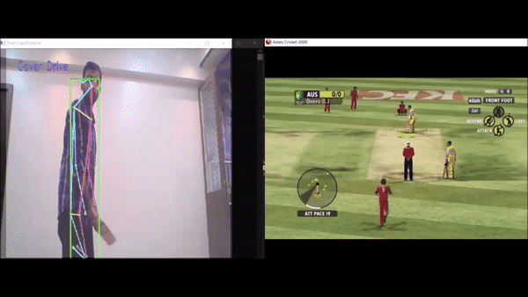
Pose-classifier based Video Game Controller – Ashes Cricket 2009

Slide 18
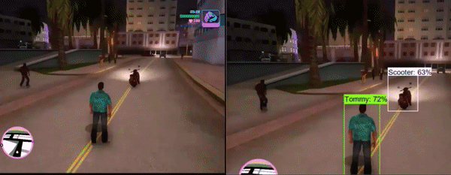
Real-time Object Detection: GTA Vice City

Slide 19
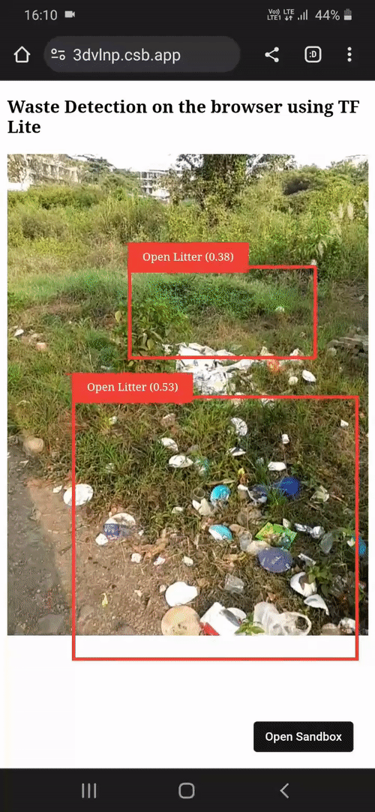
#SolveForEnvironment: Waste Detection on the browser using TF.js-TFLite

Slide 20
How do I get started?

Slide 21
Fundamentals
Intermediate
Advanced
Machine Learning Specialization by DeepLearning.AI https://www.coursera.org/specializations/machine-learning-introduction
Generative AI Learning Path by Google https://www.cloudskillsboost.google/journeys/118
Deep Learning Specialization by DeepLearning.AI https://www.coursera.org/specializations/deep-learning
Computer Vision Fundamentals with Google Cloud https://www.coursera.org/learn/image-understanding-tensorflow-gcp
Official TensorFlow website https://www.tensorflow.org
Official Keras website https://www.keras.io
DeepLearning.AI TensorFlow Developer Professional Certificate https://www.coursera.org/professional-certificates/tensorflow-in-practice
TensorFlow: Data and Deployment Specialization https://www.coursera.org/specializations/tensorflow-data-and-deployment
Generative Adversarial Networks (GANs) Specialization https://www.coursera.org/specializations/generative-adversarial-networks-gans
Natural Language Processing Specialization https://www.coursera.org/specializations/natural-language-processing
MediaPipe Solutions https://developers.google.com/mediapipe
Kaggle Models https://www.kaggle.com/models
Machine Learning Engineering for Production (MLOps) https://www.coursera.org/specializations/machine-learning-engineering-for-production-mlops
Vertex AI – Google Cloud https://cloud.google.com/vertex-ai
Advanced Machine Learning on Google Cloud https://www.coursera.org/specializations/advanced-machine-learning-tensorflow-gcp
Production Machine Learning Systems https://www.coursera.org/learn/gcp-production-ml-systems
TensorFlow: Advanced Techniques Specialization https://www.coursera.org/specializations/tensorflow-advanced-techniques
Notes:
Audience split: 20% community, 55% devs, 25% partners
(expecting heavy overlap between comm and dev)

Slide 22




Thank You.
medium.com/@tiwarinitin1999
twitter.com/@NSTiwari21
github.com/NSTiwari

